Slide 1

The National University of Computer and Emerging Sciences
Manipulator and Operators
CS 1002 Programming Fundamentals
Dr. Akhtar Jamil
Department of Computer Science

Slide 2
Goals
Operators
Selection Structure

Slide 3
Today’s Lecture

Slide 4
Bitwise Operators (integers)
Bitwise "and" operator &
Bitwise "or" operator |
Bitwise "exclusive or" operator ^
(0 on same bits, 1 on different bits)
Bitwise "ones complement" operator ~
Shift left <<
Shift right >>

Slide 5
Bitwise Operators (Example)
int i = 880; ➔ 1 1 0 1 1 1 0 0 0 0
int j = 453; ➔ 0 1 1 1 0 0 0 1 0 1
i & j (320) 0 1 0 1 0 0 0 0 0 0
i | j (1013) 1 1 1 1 1 1 0 1 0 1
i ^ j (693) 1 0 1 0 1 1 0 1 0 1
~j (-454) 1 0 0 0 1 1 1 0 1 0
i = i<<1; (1760) 1 0 1 1 1 0 0 0 0 0
unsigned
int
i = i>>1; (440) 0 1 1 0 1 1 1 0 0 0

Slide 6
Mathematical Expressions
An expression can be a constant, a variable, or a combination of constants and variables combined with operators
Can create complex expressions using multiple mathematical operators:
2
height
a + b / c

Slide 7
Using Mathematical Expressions
Can be used in assignment statements, with cout, and in other types of statements
Examples:
area = 2 * PI * radius;
cout << "border is: " << (2*(l+w));
This is an expression
These are expressions
Notes:
See pr3-05.cpp

Slide 8
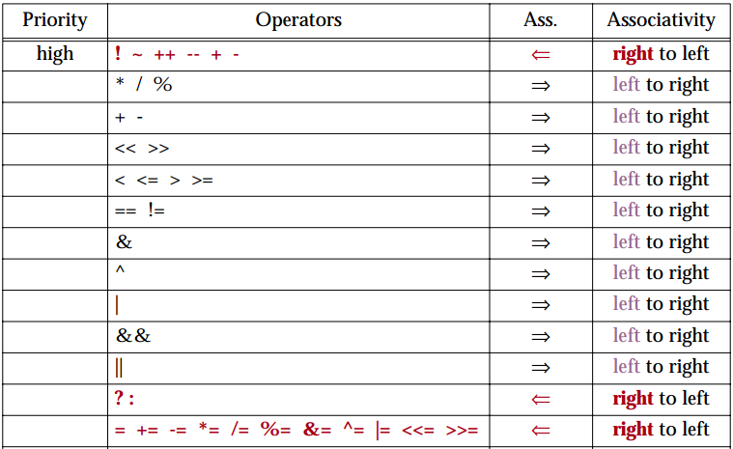
Precedence Rules
(Unary Operators)
(Arithmetic Operators)
(Arithmetic Operators)
(Bitwise shift operators)
(Relational operators)
(Equality operators)

Slide 9
Order of Operations
In an expression with more than one operator, evaluate in this order
In the expression 2 + 2 * 2 – 2
Evaluate
2nd
Evaluate
1st
Evaluate
3rd

Slide 10
Associativity of Operators
Implied grouping/parentheses
Example: - (unary negation) associates right to left
-5 ➔ -5;
--5 ➔ - (-5) ➔ 5;
---5 = -(-(-5)) = - (+5) ➔ -5

Slide 11
Associativity of Operators
* / % + - all associate left to right
3 + 2 + 4 + 1 = (3 + 2) + 4 + 1 = ((3+2)+4)+1 =(((3+2)+4) + 1)
parentheses ( ) can be used to override the order of operations
2 + 2 * 2 – 2 = 4
(2 + 2) * 2 – 2 = 6
2 + 2 * (2 – 2) = 2
(2 + 2) * (2 – 2) = 0

Slide 12
Algebraic Expressions
Multiplication requires an operator
Area = lw is written as Area = l * w;
There is no exponentiation operator
Area = s² is written as Area = pow(s, 2);
(note: pow requires the cmath header file) OR
Area = s*s;
Parentheses may be needed to maintain order of operations
is written as: m = (y2-y1)/(x2-x1);
Notes:
See pr3-06.cpp

Slide 13
How Assignment Works
Pattern: var = expression;
int X = 3;
X = 4 * 2.5 – 3; // int X;
meaning: 3-step process
(1) evaluate expression on right-hand-side.
X = 4 * 2.5 – 3; ➔ rhs = 10.0 – 3 = 7.0 (float)
(2) convert value to data type of left-hand-side.
7.0 (float) ➔ 7 (int)
(3) store converted value into variable.
(int) X ⬅ 7 (int)
3
X
7
X

Slide 14
Precedence Rules – Example 1
6 + 2 * 3 - 4 / 2
6 + 6 - 4 / 2
6 + 6 - 2
12 - 2
10

Slide 15
Precedence Rules – Example 2
3 * 4 / 2 + 3 - 1
12 / 2 + 3 - 1
6 + 3 - 1
9 - 1
8

Slide 16
Precedence Rules – Example 3
8 * 3 / 2 + 3 - 1
24 / 2 + 3 - 1
12 + 3 - 1
15 - 1
14
8 / 3 * 2 + 3 - 1
2 * 2 + 3 - 1
4 + 3 - 1
7 - 1
6

Slide 17
Precedence Rules (overriding)
For example: x = 3 * a - ++b % 3;
If we intend to have the statement evaluated differently from the way specified by the precedence rules, we need to specify it using parentheses ( )
Using parenthesis:
x = 3 * ((a - ++b)%3);

Slide 18
Selection Structure

Slide 19
Selection Structures
Condition
True
False
Do Step A
Do Step B

Slide 20
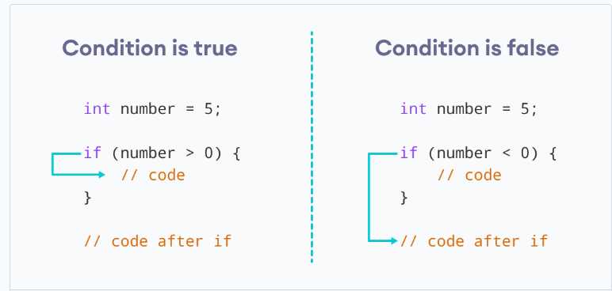
if Statement
Enables programmer to make decisions as to which statements are executed, and which are skipped.

Slide 21
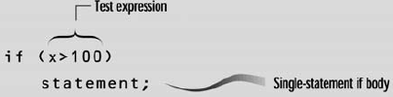
If statement (One Way)
- Syntax of if with single-statement body

Slide 22
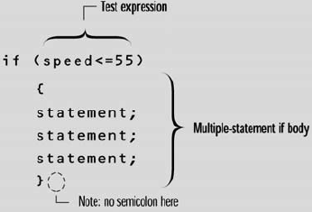
If statement (One Way)
- Syntax of if with multiple-statements body

Slide 23
Examples…. (if, one-way)
Write a program to calculate tax collection according to the following formula:
5% Tax, if salary is above 50000
3% Tax , if salary is between 30000 and 50000
2% Tax, is salary is less than 30000
In the end the program should print the calculated tax.

Slide 24
Relational Operators
Used to compare values to determine relative order
Operators:
> | Greater than
< | Less than
>= | Greater than or equal to
<= | Less than or equal to
== | Equal to
!= | Not equal to

Slide 25
Relational Expressions
Relational expressions are Boolean (i.e., evaluate to true or false)
Examples:
12 > 5 is true
7 <= 5 is false
if x is 10, then
x == 10 is true,
x != 8 is true, and
x == 8 is false

Slide 26
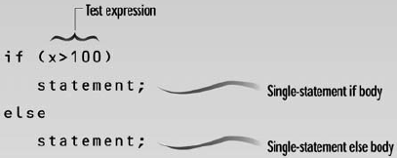
If statement (Two-Way)
- Syntax of if with single-statement body
Executed when condition is true
Executed when condition is false

Slide 27
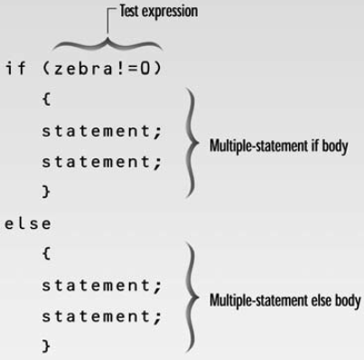
If statement (Two-Way)
- Syntax of if with single-statement body
Executed when condition is true
Executed when condition is false

Slide 28
Examples…. (if, Two-way)
Write a program that squares a number (entered by user), if it is between 10 and 100. For all other numbers, an Error message is shown and program terminates.

Slide 29
Examples…. (if, Two-way)
Write a payroll program using following rules:
Hourly rate: 100 (rupees)
If an employee works 40 hours or fewer, he is paid regular pay (hourly rate * number of hours worked).
If employees work more than 40 hours, then he WILL receive two times his hourly rate for those hours over 40, in addition to his regular pay for the first 40.

Slide 30
Nested “if...else” Statements
Purpose: To test more than one factors before we write our executable code
By nesting if structures, we write ONE COMPLETE if structure inside a SINGLE BRANCH of a parent if structure

Slide 31
Nested “if...else” Statements
if (marks>90)
{
cout<<“\nYou got A grade”;
if(nAvailable_scholorships>0)
{
cout<<“\nYou got scholorship too”;
tution_fee_due = 0;
}
}
else
{
if (marks>=50)
cout<<“\nYou passed the course”;
else
cout<<“\nYou failed the course”;
}

Slide 32
Matching the “else”
#include <iostream>
using namespace std;
int main()
{
int a, b, c;
cout<<“Enter three numbers, a, b, and c:\n”;
cin >> a >> b >> c;
if( a==b )
if( b==c )
cout << “a, b, and c are the same\n”;
else
cout << “a and b are different\n”;
return 0;
}
if( a==b )
{
if( b==c )
cout << “a, b, and c are the same\n”;
}
else
cout<< “a and b are different\n”;
else
cout << “b and c are different\n”;

Slide 33
The else...if Construction
if (marks>=80)
{
cout<<“\n You got A grade”;
cout<<“\n You won scholarship too”;
}
else if (marks>=70)
cout<<“\n You got B grade”;
else if (marks>=60)
cout<<“\n You got C grade”;
else if (marks>=50)
cout<<“\n You got D grade”;
else
cout<<“\n You are fail”;

Slide 34
Compound Conditions
COMPOUND: Multiple conditions
if ( (Age < 0) || (Age > 120) )
At least one condition must be true
if ( (Age >=1) && (Age <= 120) )
BOTH conditions must be true
INVALID:
if ( Age >=1 && <= 120 ) //Need 2 relational expressions if ( 1 <= Age <= 120 ) //Although okay in math!
Notes:
See pr4-09.cpp

Slide 35
Logical Operators
Used to create relational expressions from other relational expressions
&& | AND | New relational expression is true if both expressions are true
|| | OR | New relational expression is true if either expression is true
! | NOT | Reverses the value of an expression; true expression becomes false, false expression becomes true

Slide 36
Logical Operator Rules
Operand(s) must be bool(true/false)
true && true true || true true || false false || true ! false | true
true && false false && true false || false ! true | false

Slide 37
Logical Operator Examples
int x = 12, y = 5, z = -4;
(x > y) && (y > z) | true
(x > y) && (z > y) | false
(x <= z) || (y == z) | false
(x <= z) || (y != z) | true
!(x >= z) | false

Slide 38
Logical Precedence
Highest !
&&
Lowest ||
Example:
(2 < 3) || (5 > 6) && (7 > 8)
is true because AND is evaluated before OR

Slide 39
More on Precedence
Highest
arithmetic operators
relational operators
Lowest
logical operators
Example:
8 < 2 + 7 || 5 == 6 is true

Slide 40
Exercise-1
What will be the output of the following code?
int x=21, y=31, z=44;
if(x>16 && y>x || z%2==0 )
cout<<“Hello“;
else
cout<<“World!“;

Slide 41
Exercise-2
What will be the output of the following code?
int a = 5, b = 30;
if(a > b)
if(b > 0)
a = a + 5;
else
if(b >= 30)
b = b * 10;
cout<<”a=”<<a<<” ”<<”, b=”<<b;

Slide 42
Exercise-3
What will be the output of the following code?
int x = 5, y = 30;
if(y/x > 2)
if(y % x !=2)
x = x + 2;
cout<<x<<”\n“<<y;

Slide 43
Exercise-4
Write a program that ask the user to enter a number in the range of 1—10.
Use a selection structure to display corresponding Roman Number against each entered decimal value. E.g.,
1 → I
2 → II
3 → III
4 → IV

Slide 44
Exercise-5
Write a program that ask to input value in seconds. Then the program converts the number of seconds into days, hours, minutes, and seconds value. In the end, the program shows the output in the following format:
Days:2 Hours:13 Minuts:32 Seconds:11

Slide 45
Exercise-6
Write a program that calculate the person’s Body Mass Index (BMI). The BMI is often used to determine if a person is overweight, underweight for his/her height.
BMI is calculated as:
BMI = (weight * 703) / (height*height)
Here weight is in pounds and height is in inches.
The program should display the message:
- “Optimal Weight” if BMI is 18.5—25
- “Under Weight” if BMI is < 18.5
- “Over Weight” if BMI is > 25

Slide 46
References
Credit goes to Dr. Muhammad Aleem for preparation of slides
Text book: Starting out with c++

Slide 47
Thank You ☺

